Slide 1

MarketGenie Predicting stocks
Can we find relationships between two or more commodities?
Djiar Salim & Omid Hazara

Slide 2

Stocks - daily data
Yahoo has an API for fetching daily data
The stocks in our interests: OOIL, COPX, GOLD, AG (silver), UEC (uranium)
Stock quotes: Open, Close, High, low, adj. close

Slide 3
What do we want from our system?
- Given a stock and its historical data, we want to predict tomorrow.
Prediction by signal : Strong Buy, Weak Buy, Weak Sell, Strong Sell

Slide 4
Initial study – just surfing the web
To predict tomorrow, how far back in time do we want to analyze?
What training model is the right one?
How do we fetch the data?
How do we handle inconsistent data?
How do we define when to get a strong/weak buy/sell?

Slide 5
Initial study – classifier models
DecisionTreeClassifier
MLPClassifier (Multi-layer Perceptron classifier)
RandomForestClassifier
KNeighborsClassifier

Slide 6
Design – how do we build our system
Build consistent data build_data()
Process data get_features()
Fetch The data
get_data()
Features
Labels
INPUT: Stocks name, Start/end date, Period length (batch size)
Learn/fit
Learn()
OUTPUT: Prediction system
Predictor

Slide 7
Implementation
Python
Pandas to work with dataframes and handling data
Sklearn to build our prediction models

Slide 8
Implementation – Preproccessing training data
get_data()
- output : list of dataframes for each stock
build_data()
- A bit harder because of corner/edge cases
- output: dictionary of key:day and value:daily data

Slide 9
Implementation – Processing training data
get_features()
- Sliding window technique
- Each “window” is a training data example that becomes labeled
- output: features & labels
Labeling was done simple (if low_tomorrow > high_today then buy, if larger by .8% it’s strong buy)

Slide 10
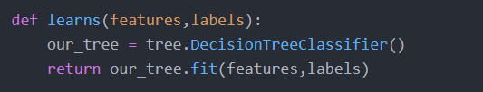
Implementation – Learning
With features and labels, we can try many different classifiers from sklearn
DecisionTreeClassifier, MLPClassifier, RandomForestClassifier, KNeighborsClassifier

Slide 11
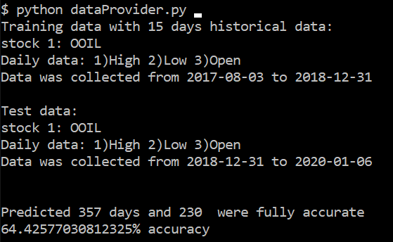
Testing – small test
Test data was processed in the same way as training data, with test data we can compare predicted labels and actual labels

Slide 12
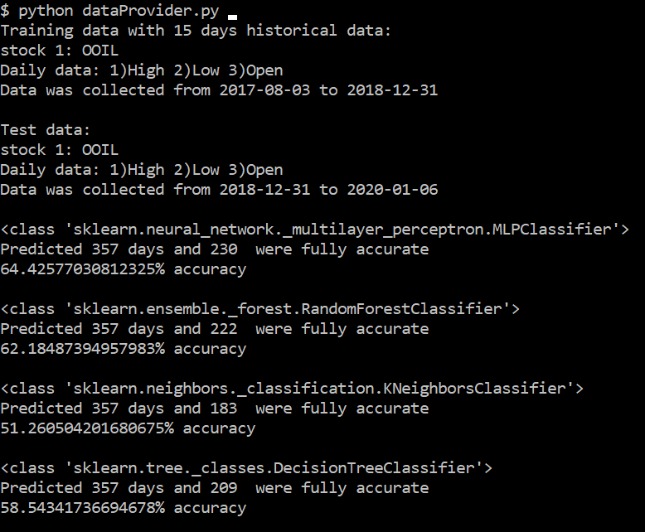
Testing – other classifiers

Slide 13
Testing – trying to find the best parameters
Problem: Too many variables to tweak
Parameters: choice of classifier, different combinations of stocks, period_length

Slide 14
Result – MLP is superior
We found out that MLP is superior when predicting
When predicting multiple stocks together, the accuracy fell

Slide 15
Demo
1) Plot massive test and comparsion [Automated]
2) Predict tomorrow

Slide 16
In the future
Make more options available for the user
Perhaps use more volatile stocks
Explore tweaking each classifier more
Better defined label
More user friendly

